Slide 1
Project Presentation through TWINMOTION
ORB University
Vol. 1: INTRODUCTION
Vol. 2: RENDERING CREATION
Presented by:
Gabriela Nessi, Jhon Heredia, Miguel Terán.

Slide 2
Vol. 2: RENDERING
CONTENT:
ORB PRESET FILE
IMPORTING THE MODEL
CREATING VIEWS
LIGHTING
ASSIGN MATERIALS
FILLING THE SCENE
RENDERING PRODUCT FORMAT & EXPORTING

Slide 3
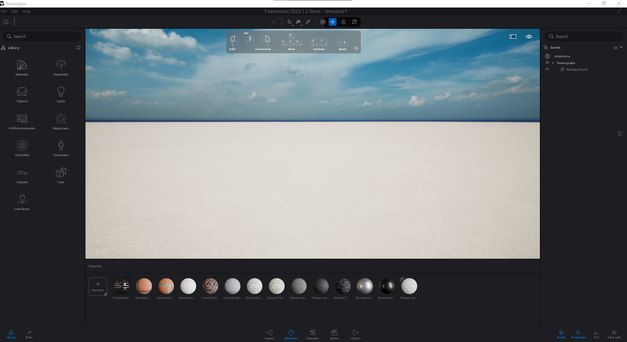
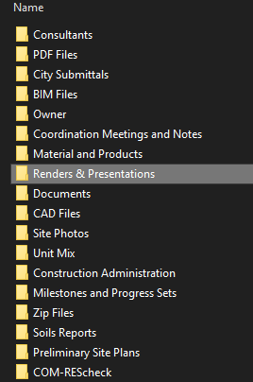
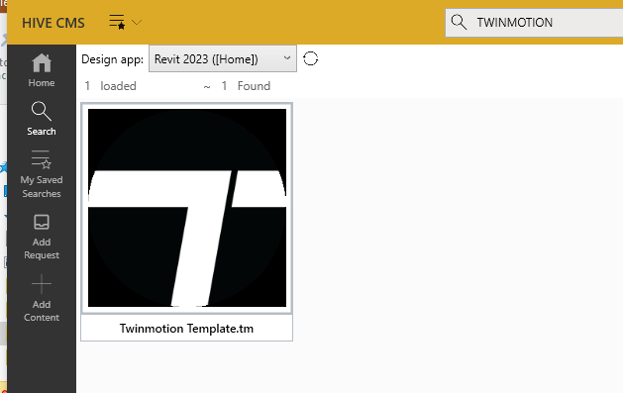
Preset File
There’s an ORB preset file (WIP) inside HIVE for Twinmotion.
It includes materials:
Materials
Preset skies
Preset media images
Save the file inside “Renders & Presentations” folder (Proposed new folder name)

Slide 4
Preset File
When opening the template file we have two options:
Import the Revit model using direct link.
Merge the project model with a preset file.
By now, we’ve covered the first option from the previous lesson, so let’s take a look to the second one.

Slide 5
Preset File
Open one of the two files you want to merge, go to the File menu and select “Merge”.
ORB
Preset
File
Project model
Merged file

Slide 7
Preset File
It may look the same, but the model is in there.
Just orbit around to find the model.
Twinmotion places the model with Revit coordinates, so it may no be at the origin point.

Slide 8
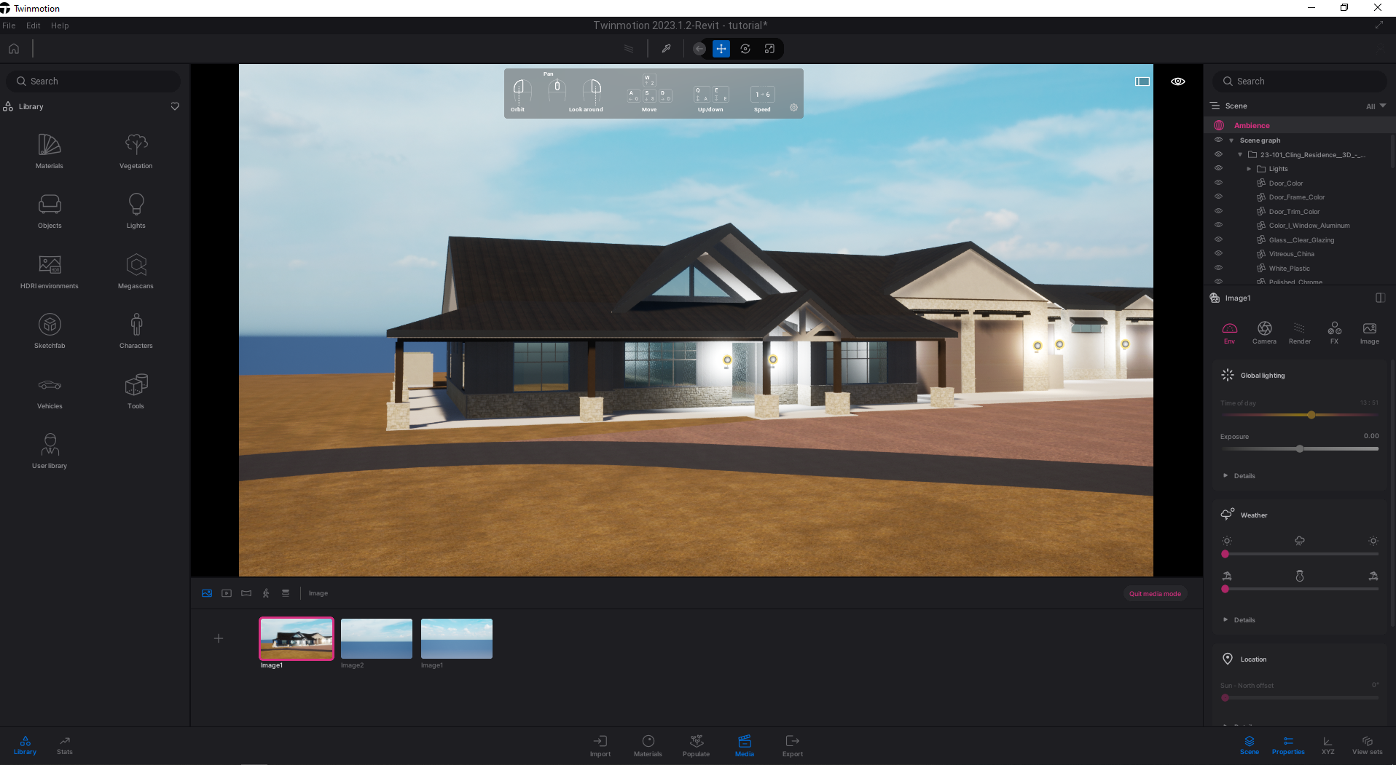
Choosing the view
Great!, you found the model.
Now with the model inside Twinmotion, it’s time for the fun part.

Slide 9
Choosing the view
Click on one of the 3 images to enter media mode
Orbit around the model until we get to a desired view.
Once we get the desired view, hover the mouse in one of the images, and click de “Refresh” button.
This will set what we’re seeing in the navigation pane to the image frame.
Just like taking a photograph.

Slide 11
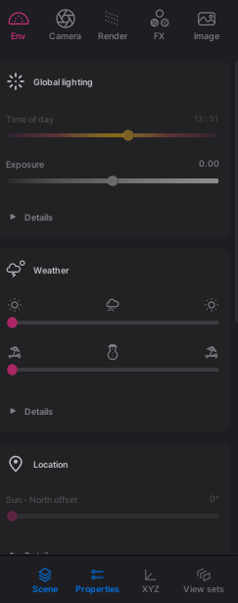
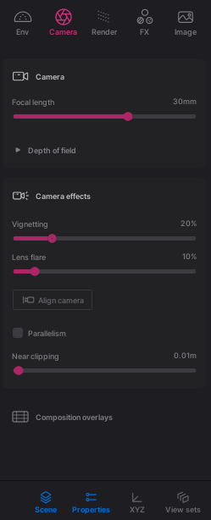
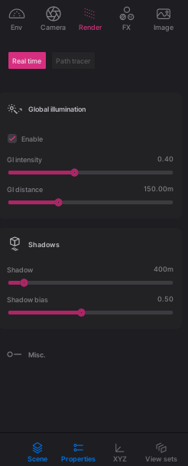
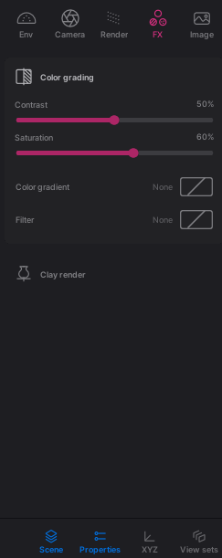
Choosing the view
What are all these buttons?
So many switches…
Overwhelming, isn’t?
These are media properties, we can change the camera properties, environment, effects, render settings, etc.

Slide 12
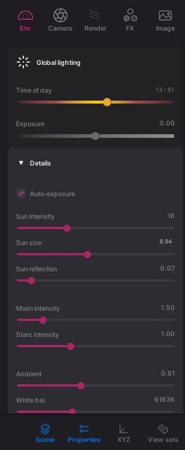
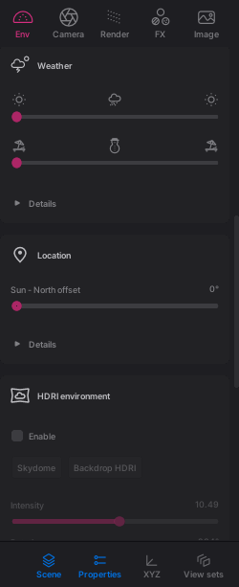
Lighting
Once the frames are setup, we can start playing with the lighting.
Since we’re doing exterior shots, we’re only changing the environment and ambiance.

Slide 13
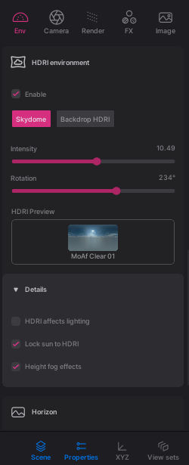
Lighting - Environment
HDRI stands for “High dynamic range imaging”.
Basically, they are photos or videos keeping information about variation in light levels.
We can get a bunch of them in the asset browser.

Slide 14
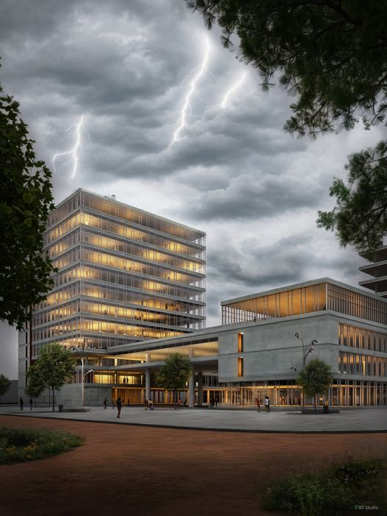
Lighting - Environment
Try to avoid distracting effects.
The main character is the building, not the environment.
Be sure to check how materials react in different lights and shadows.

Slide 15
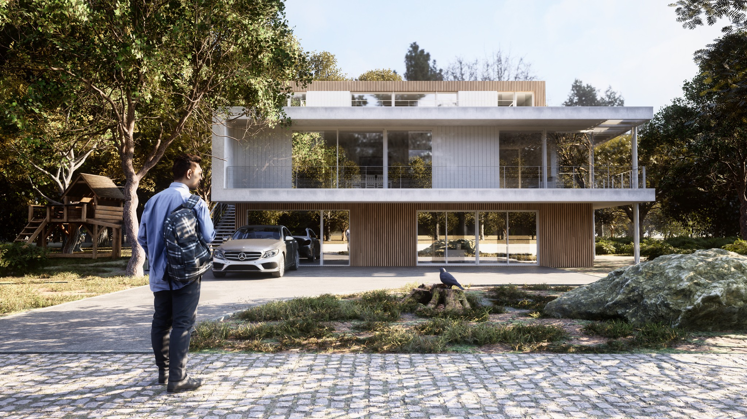
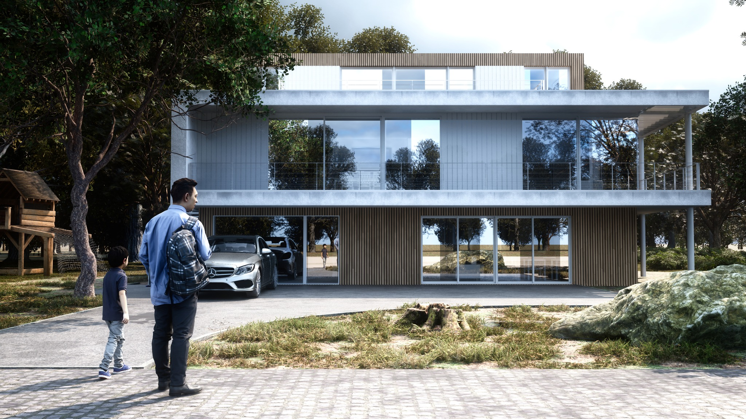
Lighting - Environment
Different lighting can provide different results.

Slide 16
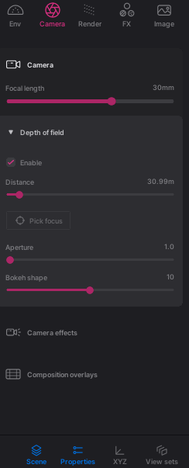
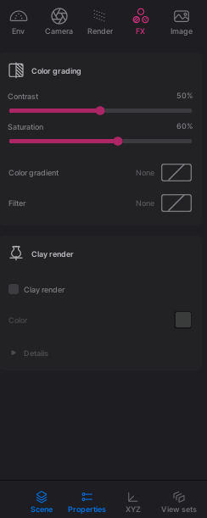
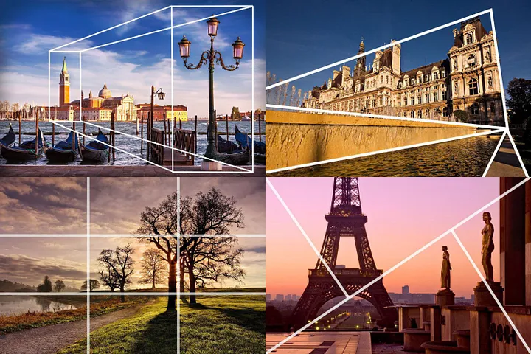
Camera and effects
Camera and composition settings.
Non-disruptive post-production effects.

Slide 17
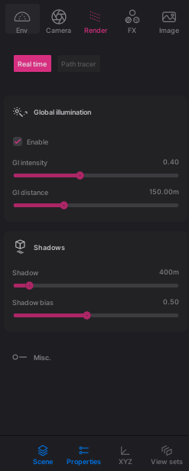
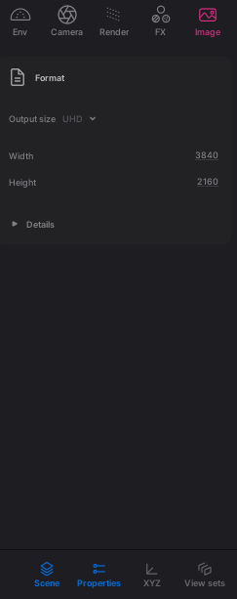
Render and Image settings
Global illumination: how light bounces from surface to surface.
Shadows offsets and intensity.
Render image resolution and quality.

Slide 18
Assigning Materials
Assigning materials is as easy as “drag-and-drop”.
You can choose from two different libraries:
ORB Preset File
Offline/online Twinmotion library

Slide 20
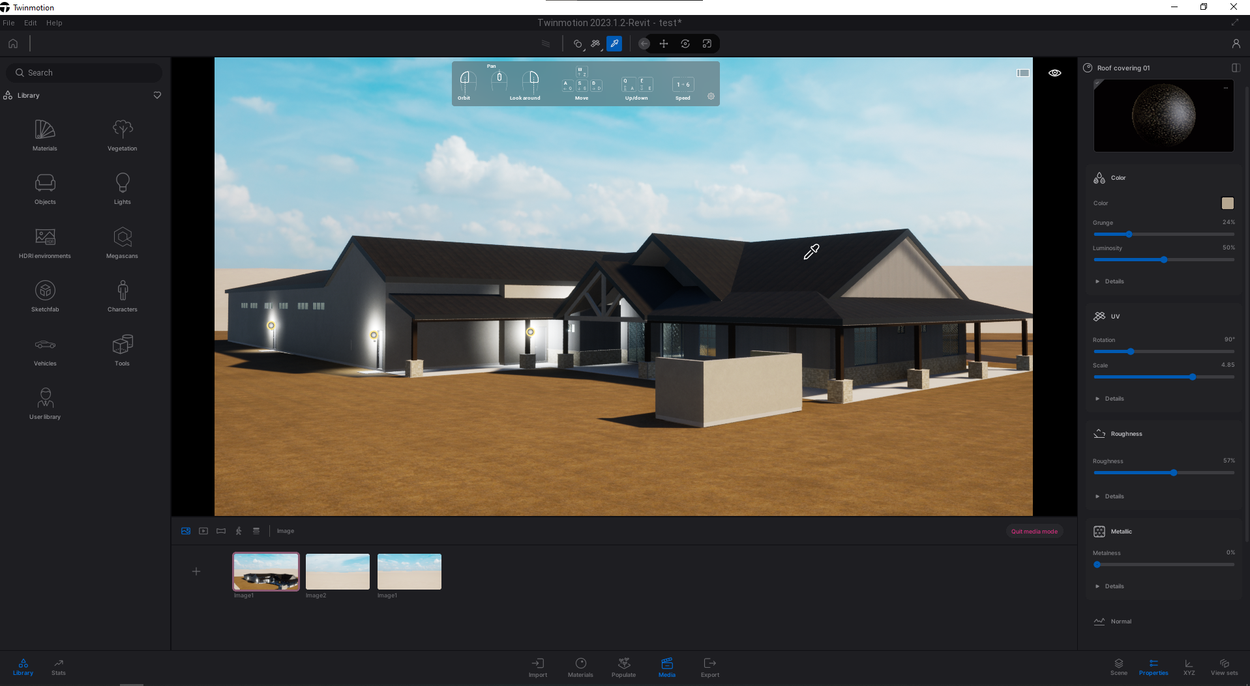
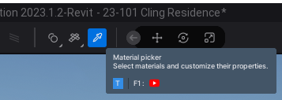
Assigning Materials
When applying a material, almost immediately we get to see their properties panel on the right side.
If not, the eyedropper tool is your best friend.

Slide 21
Assigning Materials
This is where we can change the material looks.
Diffuse color, scale, rotation, etc.
Also, modify the surface details, illusion of depth, and imperfections.

Slide 23
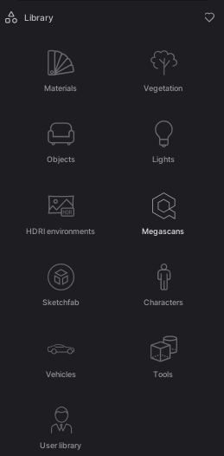
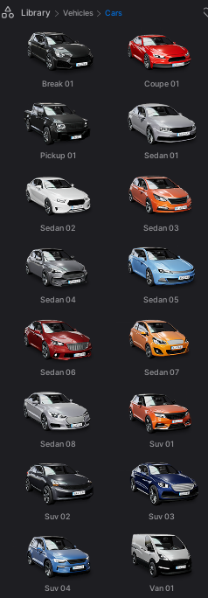
Placing Objects
Twinmotion has a large collection of assets ready to use in our scene.
Vegetation, humans, animals, and vehicles.
Vegetation can be placed to large areas with “painting” and scatter tools.
All of these will not appear in your Revit model.

Slide 24
Placing Objects
In humans, we can place them standing still, walking, doing miscellaneous stuff, etc.

Slide 25
Placing Objects
In vehicles we can only change their color and orientation.

Slide 26
Placing Objects
Each category of object have different type of properties.
For some vegetation we can change how old (size) they are.

Slide 27
Placing Objects
Vegetation can be placed randomly through an entire plane.
Size for each object can be changed.

Slide 28
Placing Objects
It also can be “painted” on the face of an object.
We can change the diameter of the brush.
As well the density of each object.

Slide 29
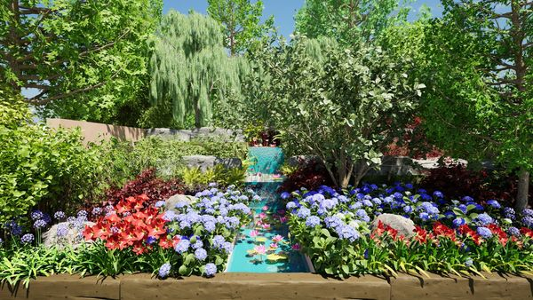
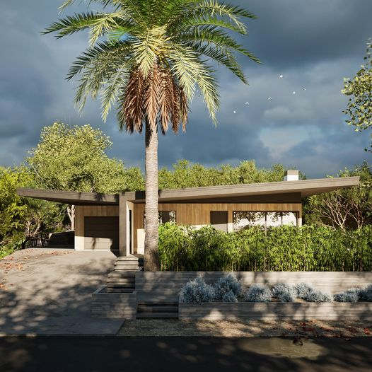
Placing Objects
Don’t exaggerate landscaping.
Too much of it may be distracting and hide the building.

Slide 30
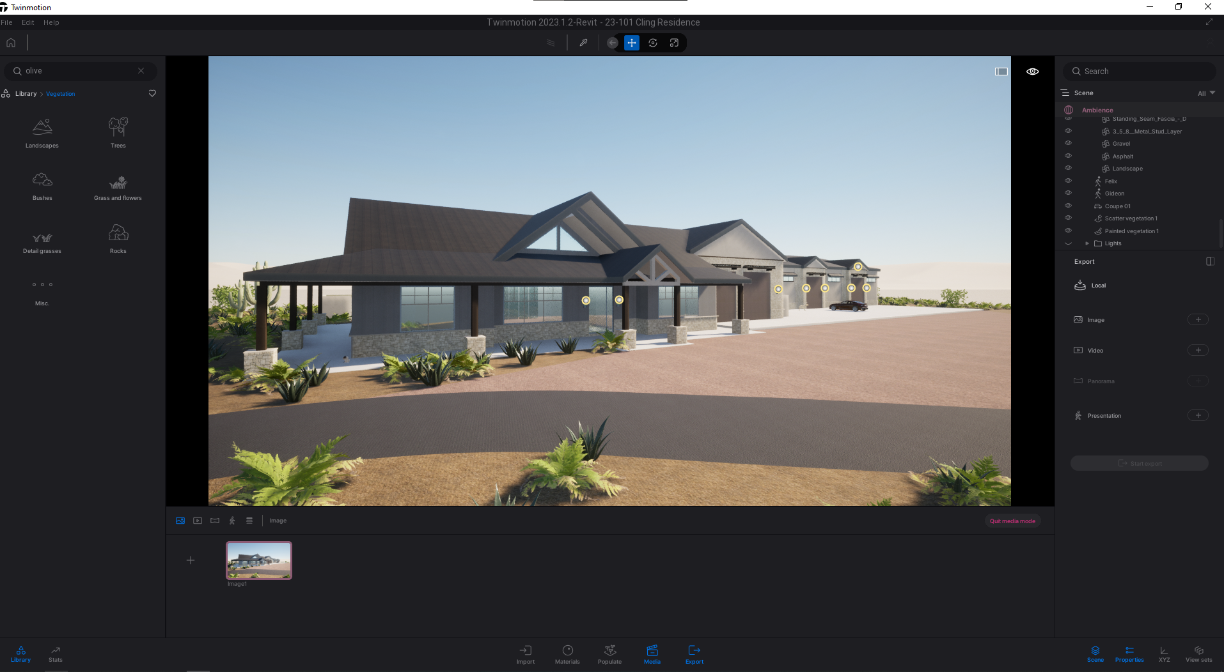
Rendering the scene
Now with everything in place it’s time to export our scene.
We can export:
Still images
Videos
Panoramic/360 images
Presentations

Slide 31
Rendering the scene
To export an image, we can go back to one of the views we created at the beginning.
Click the “Export” button to select which images to export.

Slide 32
Things to note
The software will give you the information you put in.
What you see in your screen, may not be what the client sees in his.
His cell phone may be his screen most probably…
Have a sense of scale, use images or temporary 3D models as reference.

